Slide 1

Predicting Litecoin Price Prediction using Machine Learning
Guided By: Deepak Sir.
Name : Diksha Marathe

Slide 2
Contents
1. Introduction:
2. Data Preparation:
3. Model Building:
4. Model Evaluation:
5. Visualizations:
6. Results and Conclusion:

Slide 3
Importing The Libraries :
1. Pandas (pd): Pandas is a popular Python library for data manipulation and analysis. It provides data structures like DataFrame and Series, making it easier to work with structured data like CSV files.
2. NumPy (np): NumPy is a fundamental library for numerical computations in Python. It provides support for large, multi-dimensional arrays and matrices, along with mathematical functions to operate on these arrays.
3. Seaborn: Seaborn is a data visualization library based on Matplotlib. It provides a high-level interface for creating informative and attractive statistical graphics.
4. Matplotlib.pyplot (plt): Matplotlib is a versatile plotting library in Python. The pyplot module provides a convenient interface for creating various types of plots and charts.

Slide 4
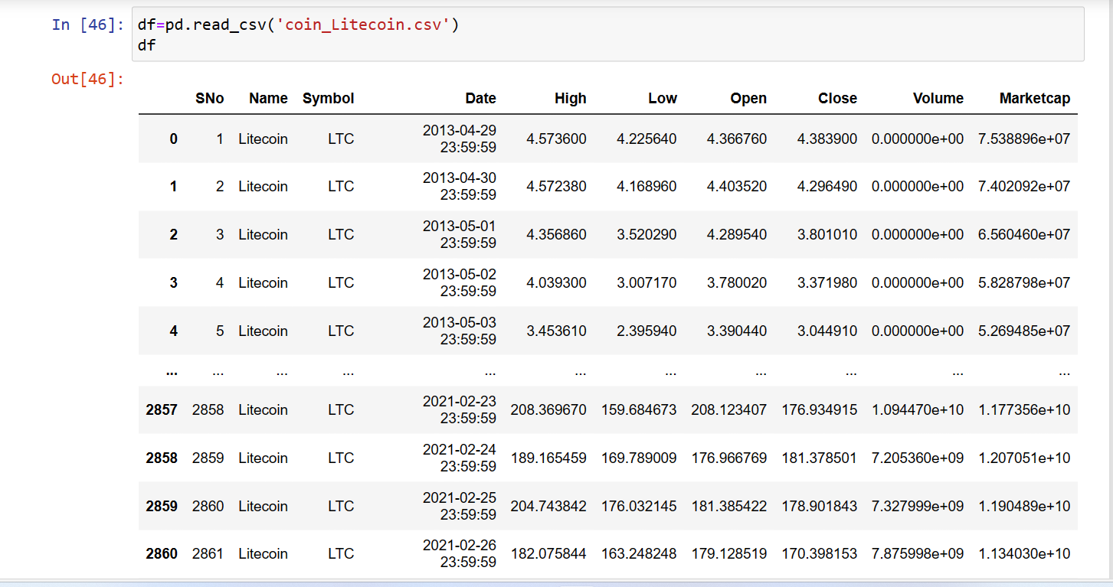
Litecoin Historical Data
Loading the data to pandas Data Frame
The data format on Pandas
2862 rows × 10 columns

Slide 5
Data Cleaning and Feature Selection
Processing of Lost data
Processing of Possible Exceptions, errors, or abnormal values
Combination of data from multiple data sources
Generally, a dataset has many features, some of which may be redundant or irrelevant to the value to be predicted
Why feature selection :-
Simplify models to make them easy for users to interpret
Reduce the training time
Avoid dimension explosion
Improve model generalization and avoid overfitting

Slide 6
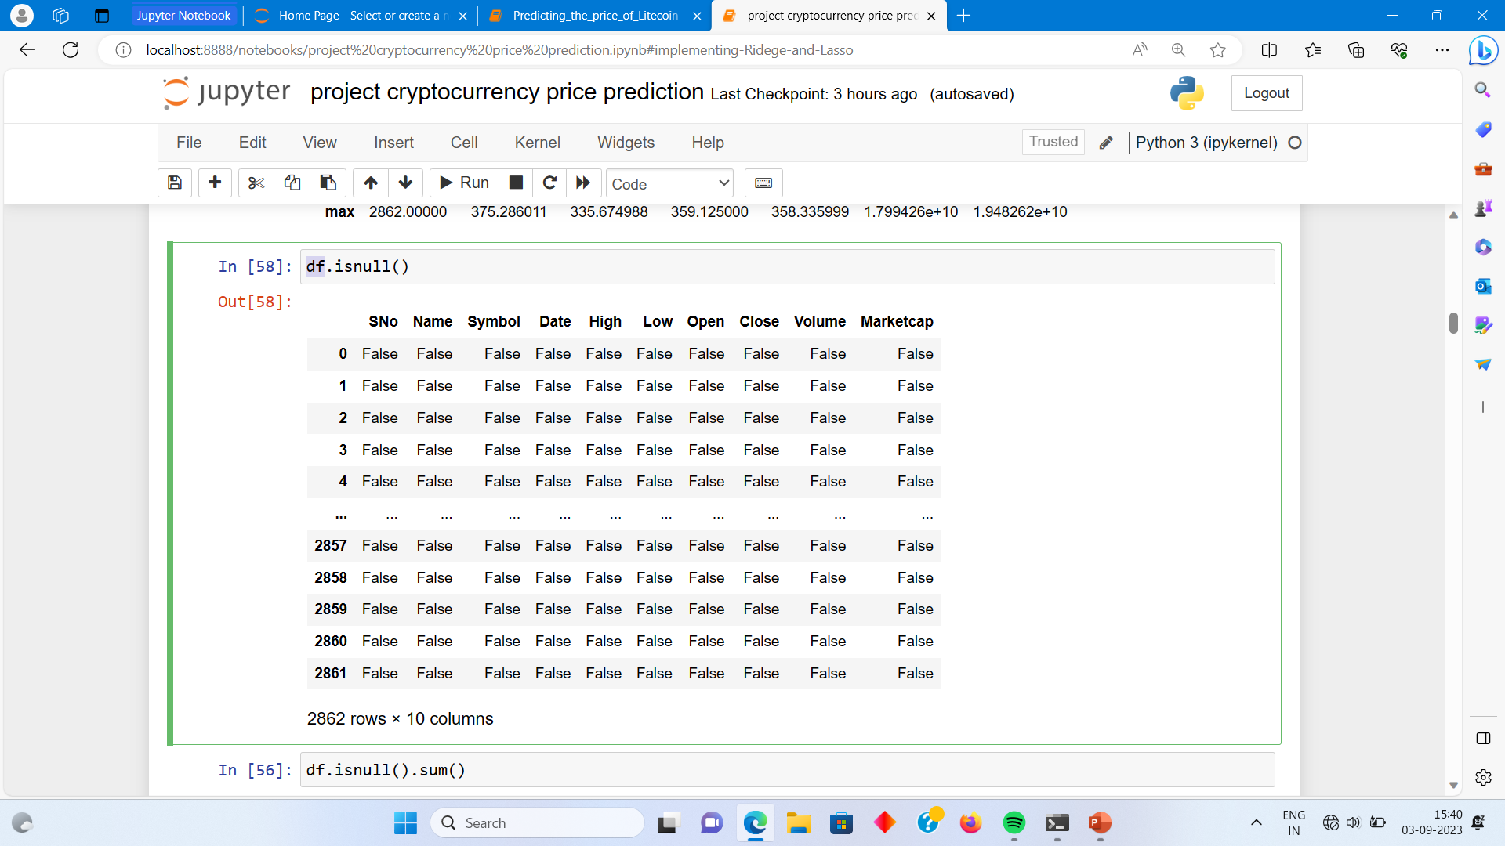
Litecoin Data Preparation
Feature Selection is the process of removing redundant features, while retaining those features that have high disambiguation capabilities.

Slide 7
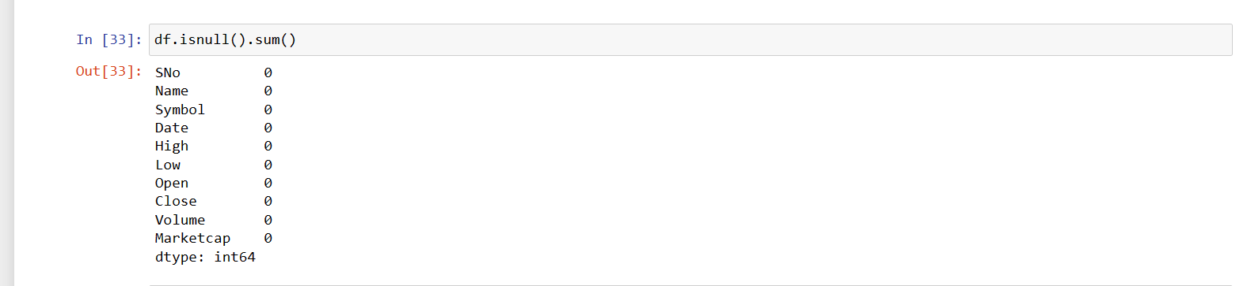
There is no null values in our dataset.

Slide 8
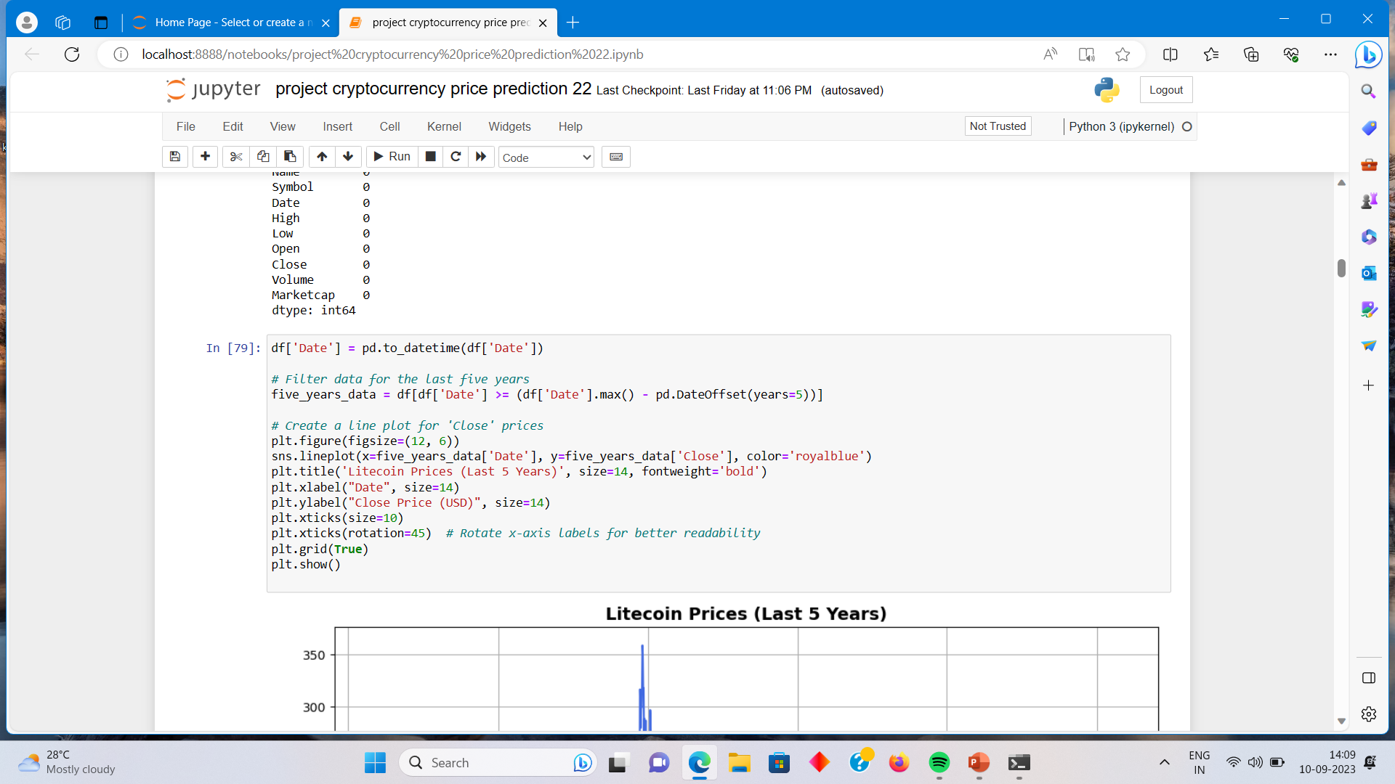
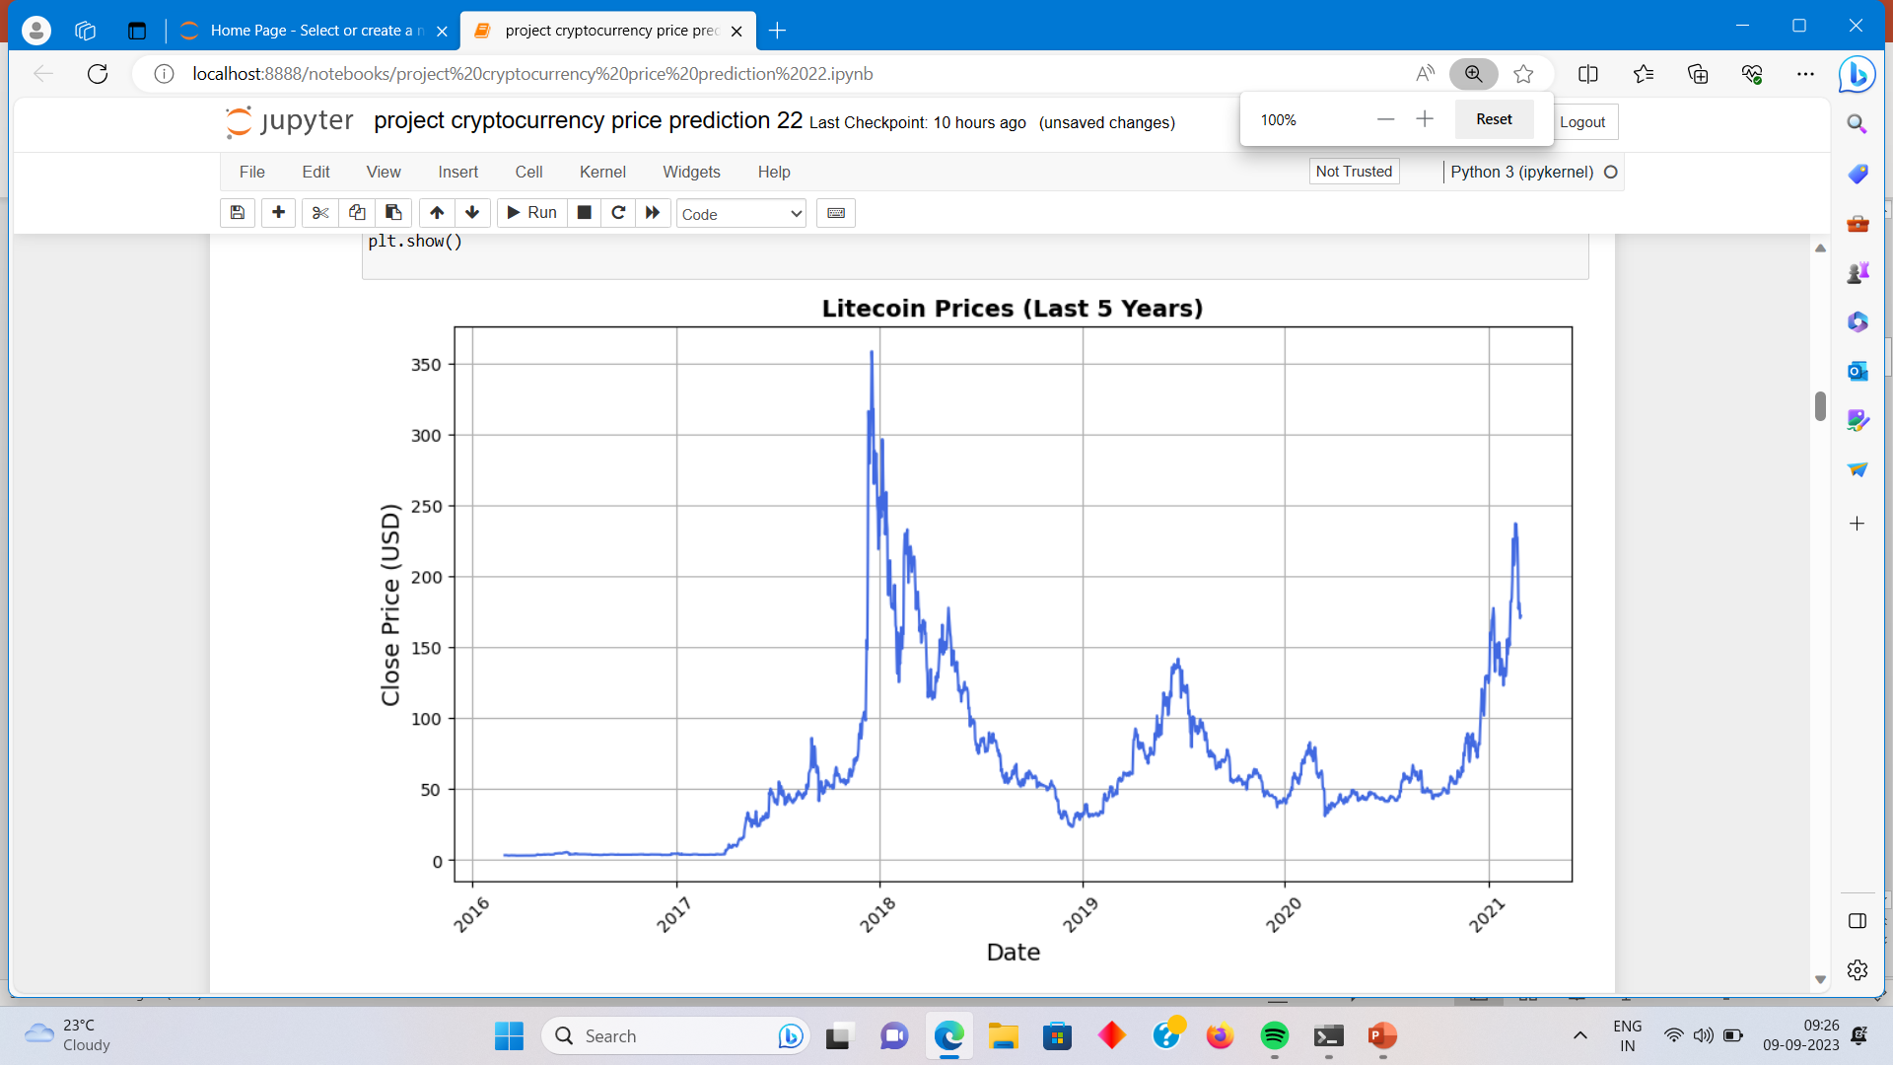

Slide 9
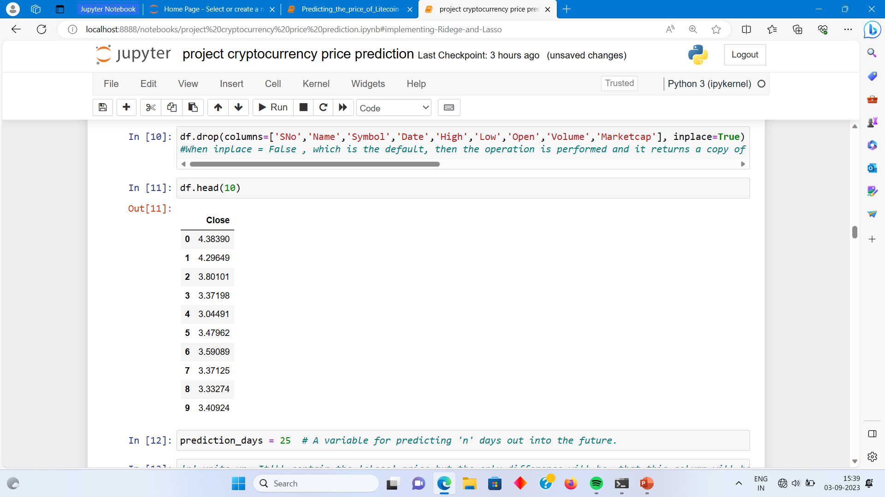

Slide 10
Outliers
Outliers are observations that are significantly different from other data points, which is either very small or large.
Thus can affect the overall observation made from the data series.
Even the best machine learning algorithms will underperform if outliers are not cleaned from the data because outliers can adversely affect the training process of a machine learning algorithm, resulting in a loss of accuracy.

Slide 11
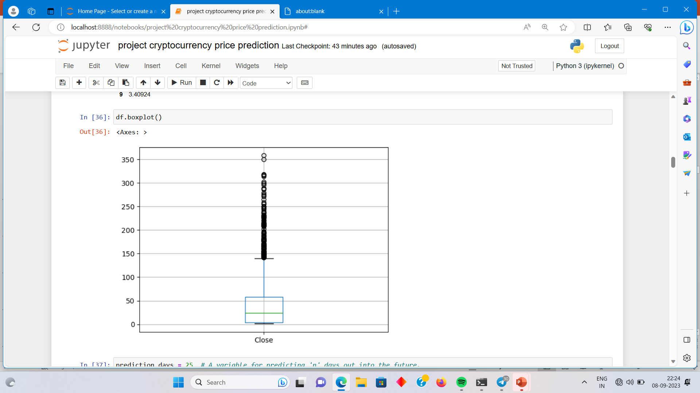
Boxplot
The very purpose of this diagram is to identify outliers and discard it from the data series before making any further observation so that the conclusion made from the study gives more accurate results not influenced by any extremes or abnormal values.

Slide 12
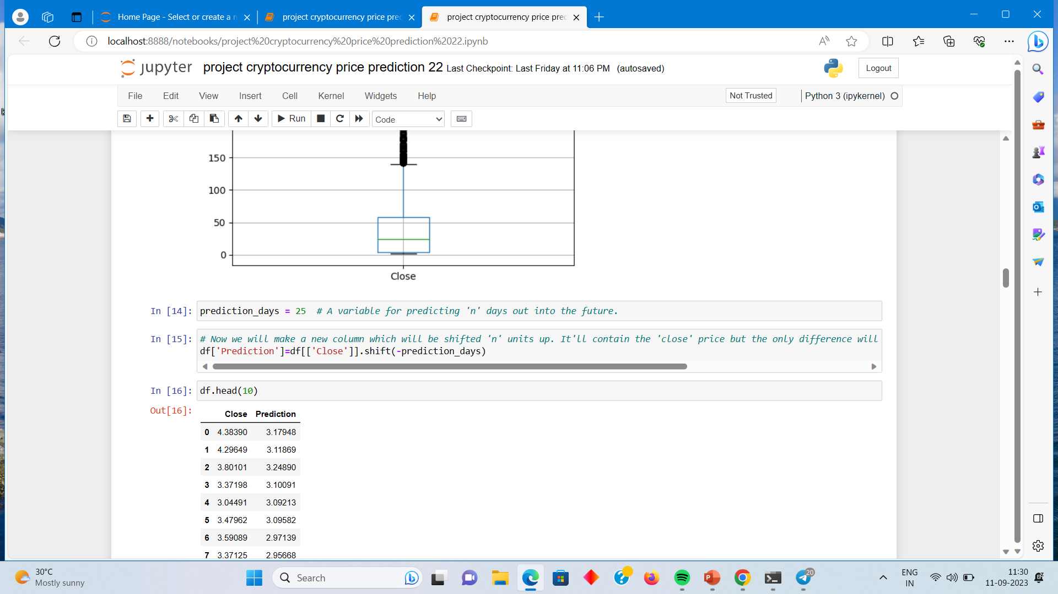
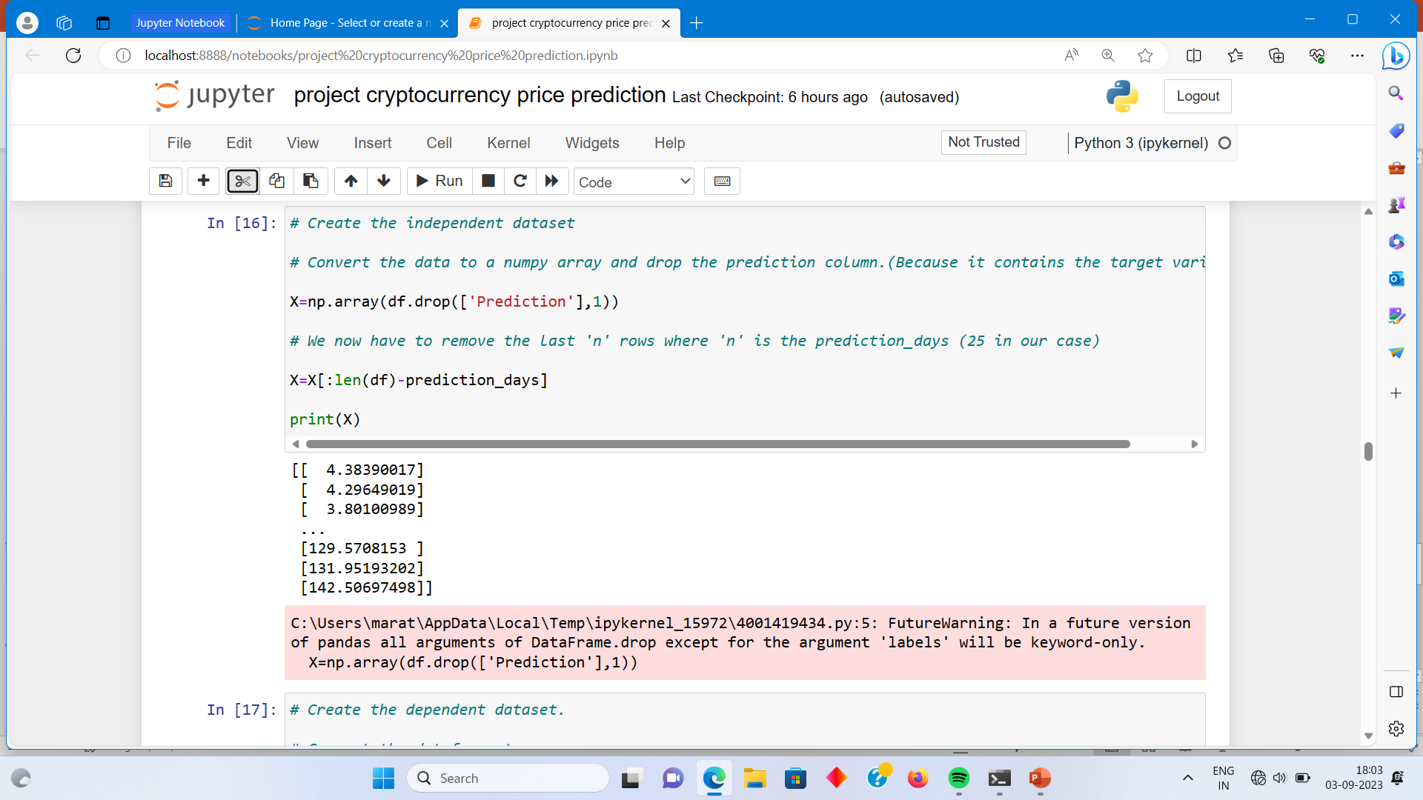
Data Preparation :-

Slide 13
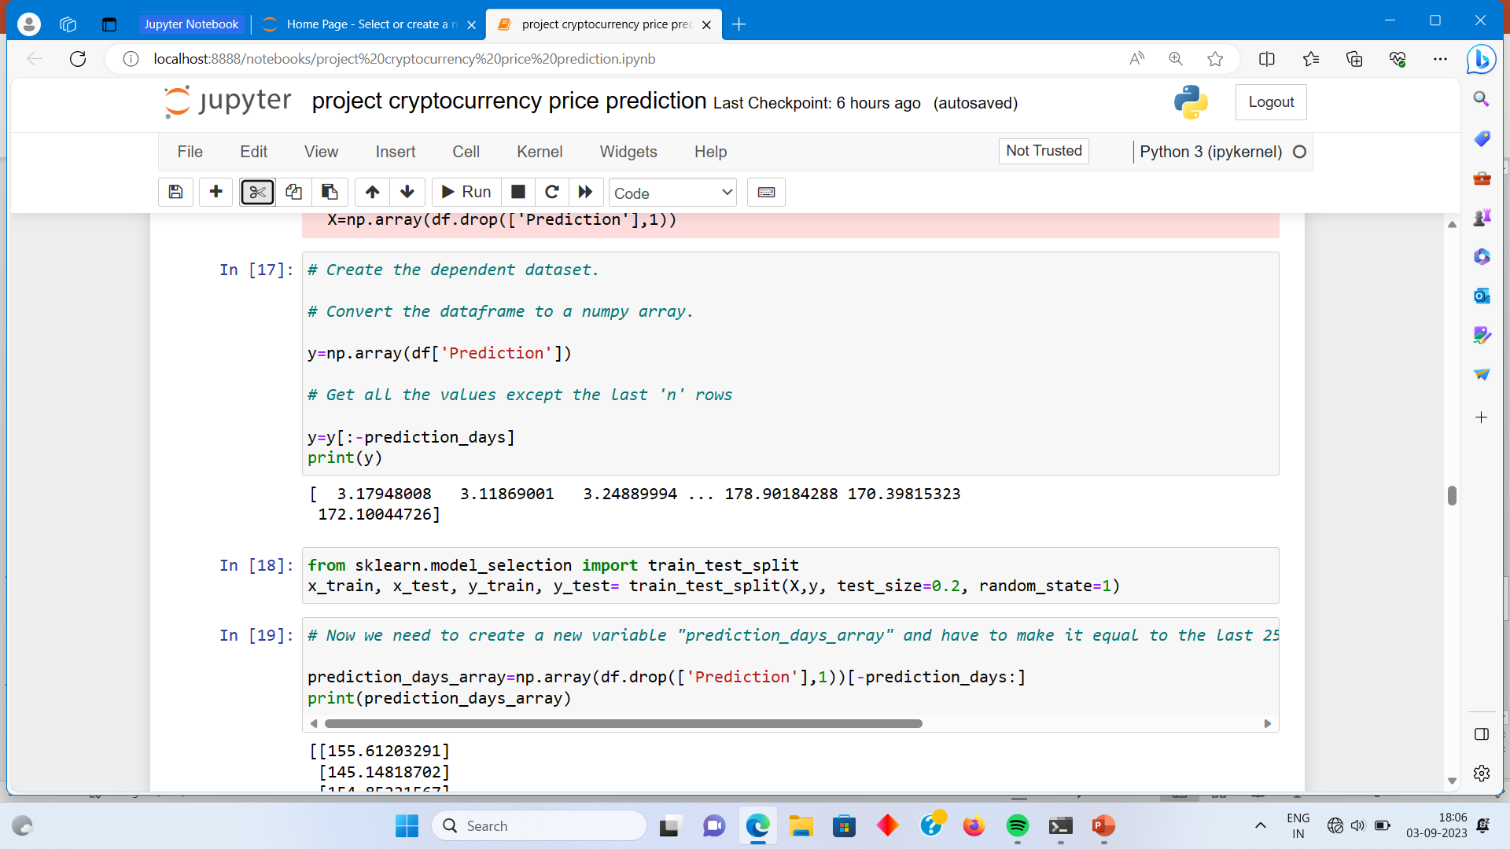

Slide 14
Independent and Dependent Variables (X and y): In machine learning, X represents the independent variables (features) that are used to make predictions, and y represents the dependent variable (target) that you want to predict.
Train-Test Split (train_test_split): This is a common step in machine learning where you split your data into training and testing sets. The training set is used to train the model, while the testing set is used to evaluate its performance.

Slide 15
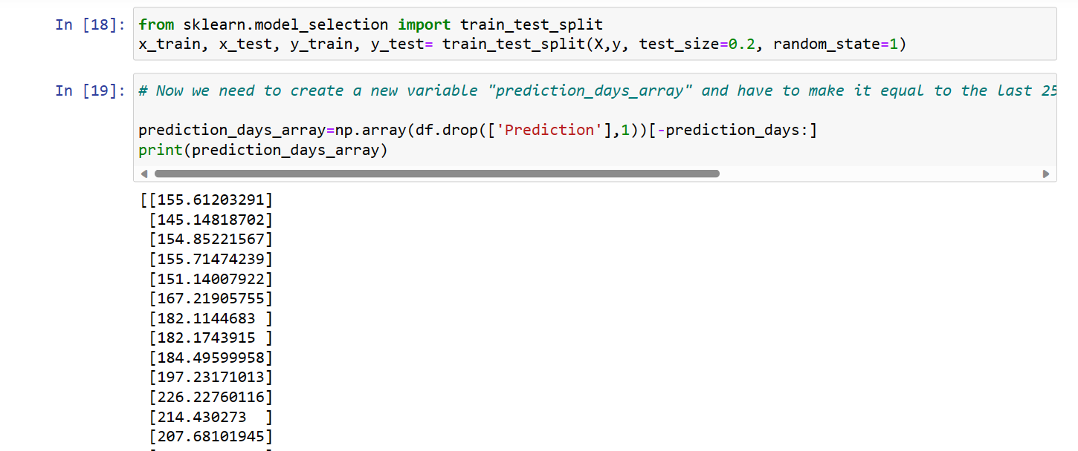
Splitting the data into train and test :-
Divide the data into attributes and labels .
Separate the train and test set.

Slide 16
Model Building:
- The ML code uses a linear regression model, which assumes a linear relationship between the features and the target variable.
- The model is trained using the training data, and the coefficients and intercept are calculated to represent the relationship between the features and the target variable.
Model Evaluation:
- The R-squared score is a metric that measures the proportion of the variance in the target variable that is predictable from the features. A higher R-squared score indicates a better fit of the model to the data.
- The mean squared error (MSE) measures the average squared difference between the predicted and actual values. A lower MSE indicates better accuracy of the model.

Slide 17
Linear regression
Linear regression is one of the easiest and most popular Machine Learning algorithms. It is a statistical method that is used for predictive analysis. Linear regression makes predictions for continuous/real or numeric variables such as sales, salary, age, product price, etc.
Linear regression algorithm shows a linear relationship between a dependent (y) and one or more independent (y) variables, hence called as linear regression. Since linear regression shows the linear relationship, which means it finds how the value of the dependent variable is changing according to the value of the independent variable.
The linear regression model provides a sloped straight line representing the relationship between the variables.

Slide 18
The importance of using linear regression for this model is that it allows us to establish a relationship between the "close" column and the target variable, which is the "25 days up" column indicating whether the price will increase or not.
Linear regression is a simple yet powerful technique that helps us understand the linear relationship between two variables. In this case, it helps us determine how changes in the closing price of Litecoin may be associated with the likelihood of an upward price movement in the next 25 days.
By fitting a linear regression model to the data, we can estimate the coefficients that represent the strength and direction of the relationship. These coefficients provide insights into how much the closing price influences the probability of a price increase.
Additionally, linear regression allows us to make predictions based on these estimated coefficients. We can input new values for the closing price and use the model to estimate the probability of an upward price movement in the next 25 days.
Overall, linear regression is valuable for this model as it helps us understand the relationship between the closing price and the likelihood of a price increase, and enables us to make predictions based on this relationship.

Slide 19
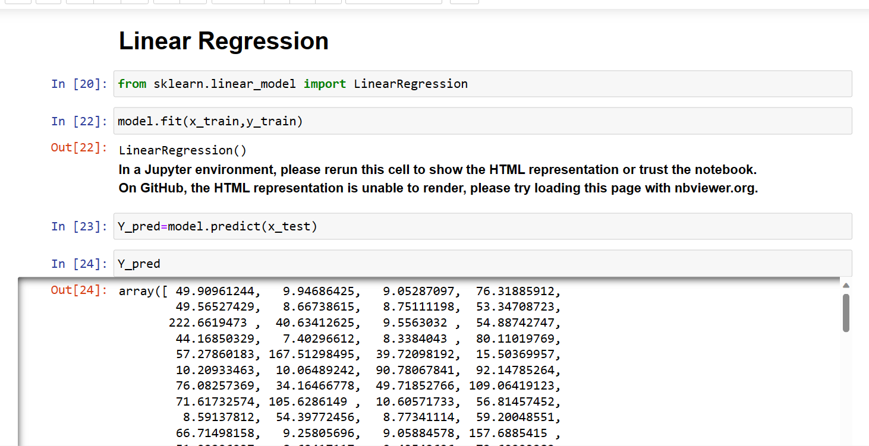

Slide 20
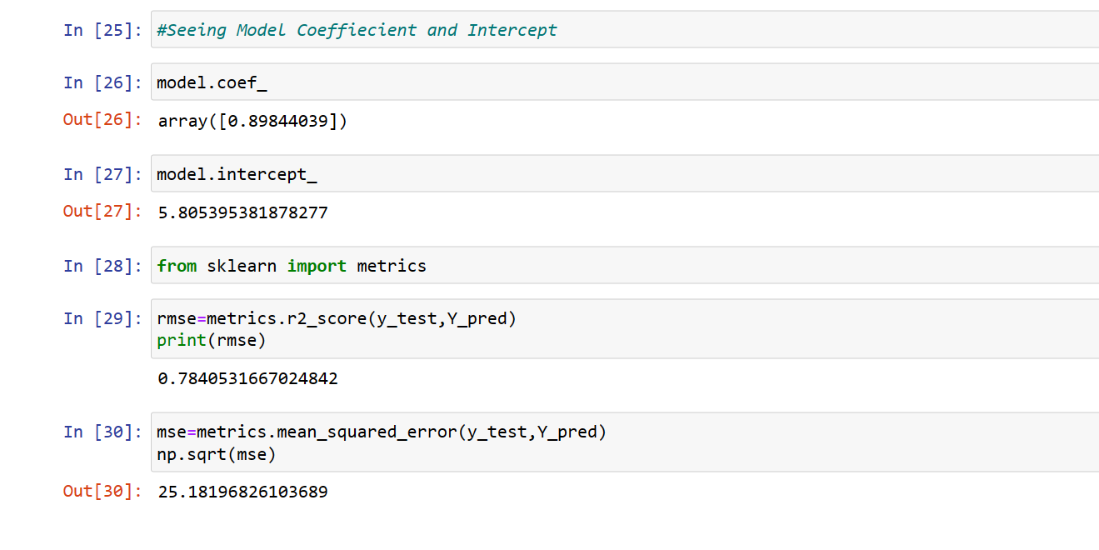

Slide 21
Ridge and Lasso’s Regression : (L1 and L2 Regularization)
Ridge and Lasso's regression are a powerful technique for regularizing linear regression models and preventing overfitting. They both add a penalty term to the cost function, but with different approaches. Ridge regression shrinks the coefficients towards zero, while Lasso regression encourages some of them to be exactly zero. These techniques can be implemented easily in Python using scikit-learn, making it accessible to a wide audience. By understanding and implementing Ridge and Lasso regression, you can improve the performance of your linear regression models and make more accurate predictions on new data.

Slide 22
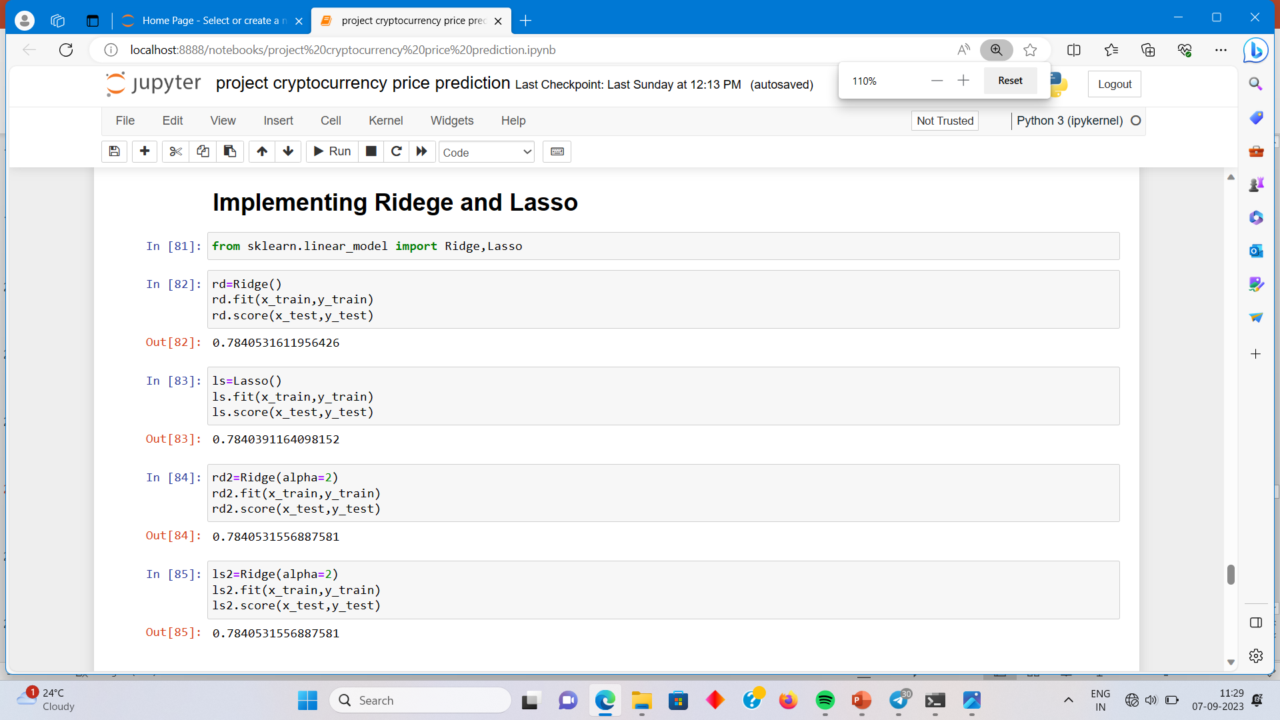

Slide 23
Gradient Boosting Regression
Gradient boosting is a powerful machine learning technique that is often used for predictive modeling tasks. It combines multiple weak prediction models, typically decision trees, to create a stronger and more accurate prediction model.
Here are some reasons why gradient boosting is commonly used:
1. Improved accuracy: Gradient boosting can significantly improve the accuracy of predictions compared to using a single decision tree or other models. By combining multiple weak models, it can capture complex relationships and patterns in the data.
2. Handling different types of data: Gradient boosting can handle both numerical and categorical features, making it versatile for various types of datasets.

Slide 24
3. Feature importance: Gradient boosting provides insights into feature importance, allowing us to understand which features have the most significant impact on the predictions. This information can be valuable for feature selection and understanding the underlying factors driving the predictions.
4. Robustness to outliers: Gradient boosting is relatively robust to outliers in the data, as it combines multiple weak models and reduces their individual impact.
5. Flexibility: Gradient boosting can be applied to a wide range of machine learning tasks, including regression, classification, and ranking problems.
In summary, gradient boosting is a powerful technique that can improve prediction accuracy, handle different types of data, provide insights into feature importance, and offer flexibility for various machine learning tasks.

Slide 25
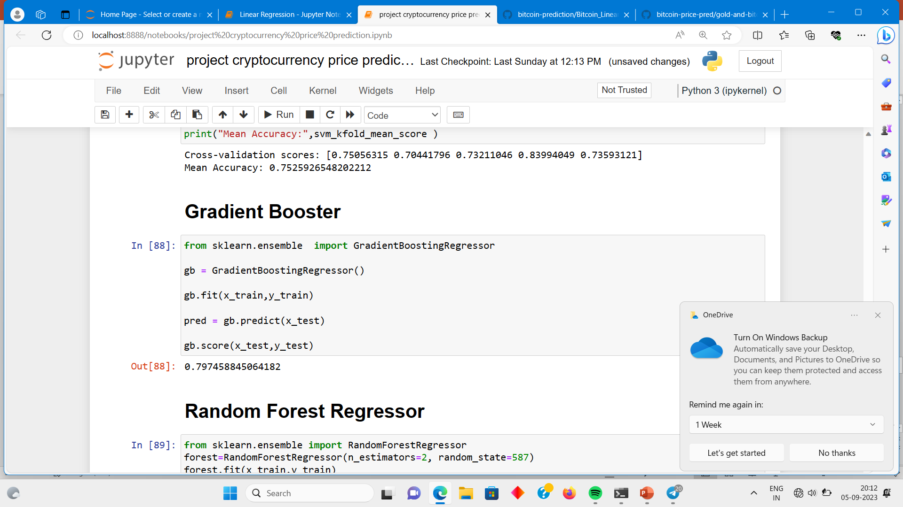

Slide 26
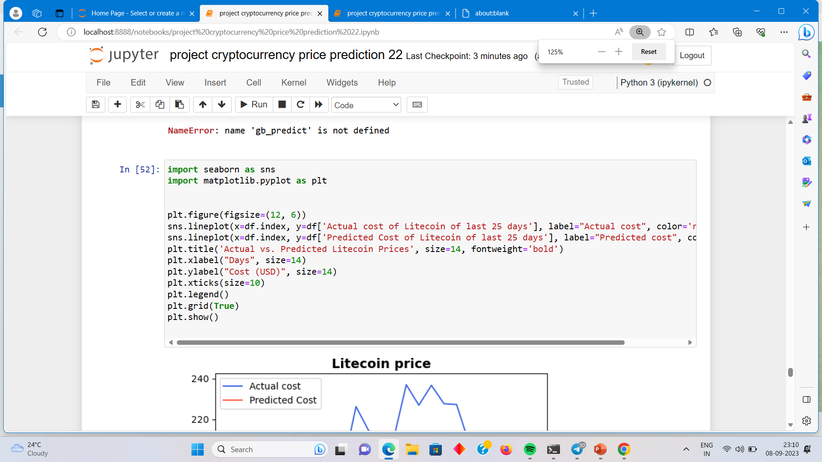
Visualization

Slide 27
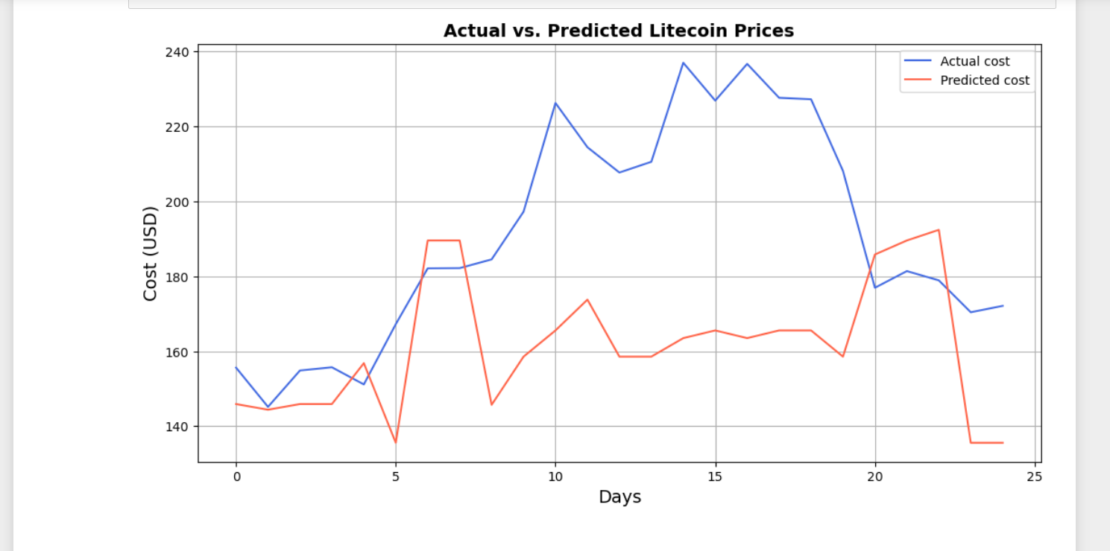

Slide 28
Results and Conclusion
- The coefficients obtained from the model represent the effect of each feature on the target variable. Positive coefficients indicate a positive relationship, while negative coefficients indicate a negative relationship.
- The intercept represents the value of the target variable when all the features are zero.
- Based on the evaluation metrics and results, it can be concluded that the ML model has a certain level of accuracy in predicting the target variable.

Slide 29
Thanks !

